Slide 1


Advisor: Xuning Yang​
Team Members: Yanpeng Zhang, Shiyi Liu, Yuqi Xiao, Ziqin Wang, Ziqiang Li, Peilin Wu

Slide 2
FinRocket 1.0

Slide 3
Content
Part 2 Model
Logic
Advantage
Part 1 Data Preview
Data Insights
Part 3 Improvement
Industry Analysis
Risk Warning
Hedge

Slide 4

01 Data Preview
DATA PREVIEW
MODEL
IMPROVEMENT

Slide 5

01 Data Preview
DATA PREVIEW
MODEL
IMPROVEMENT

Slide 6
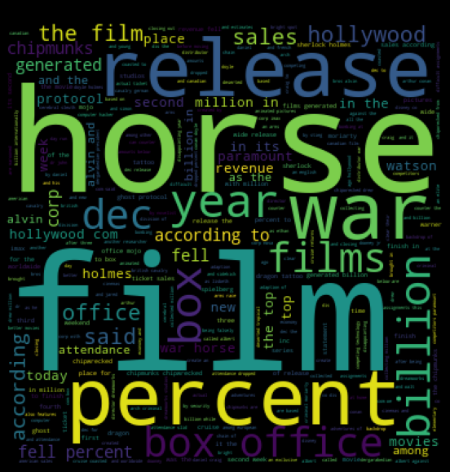
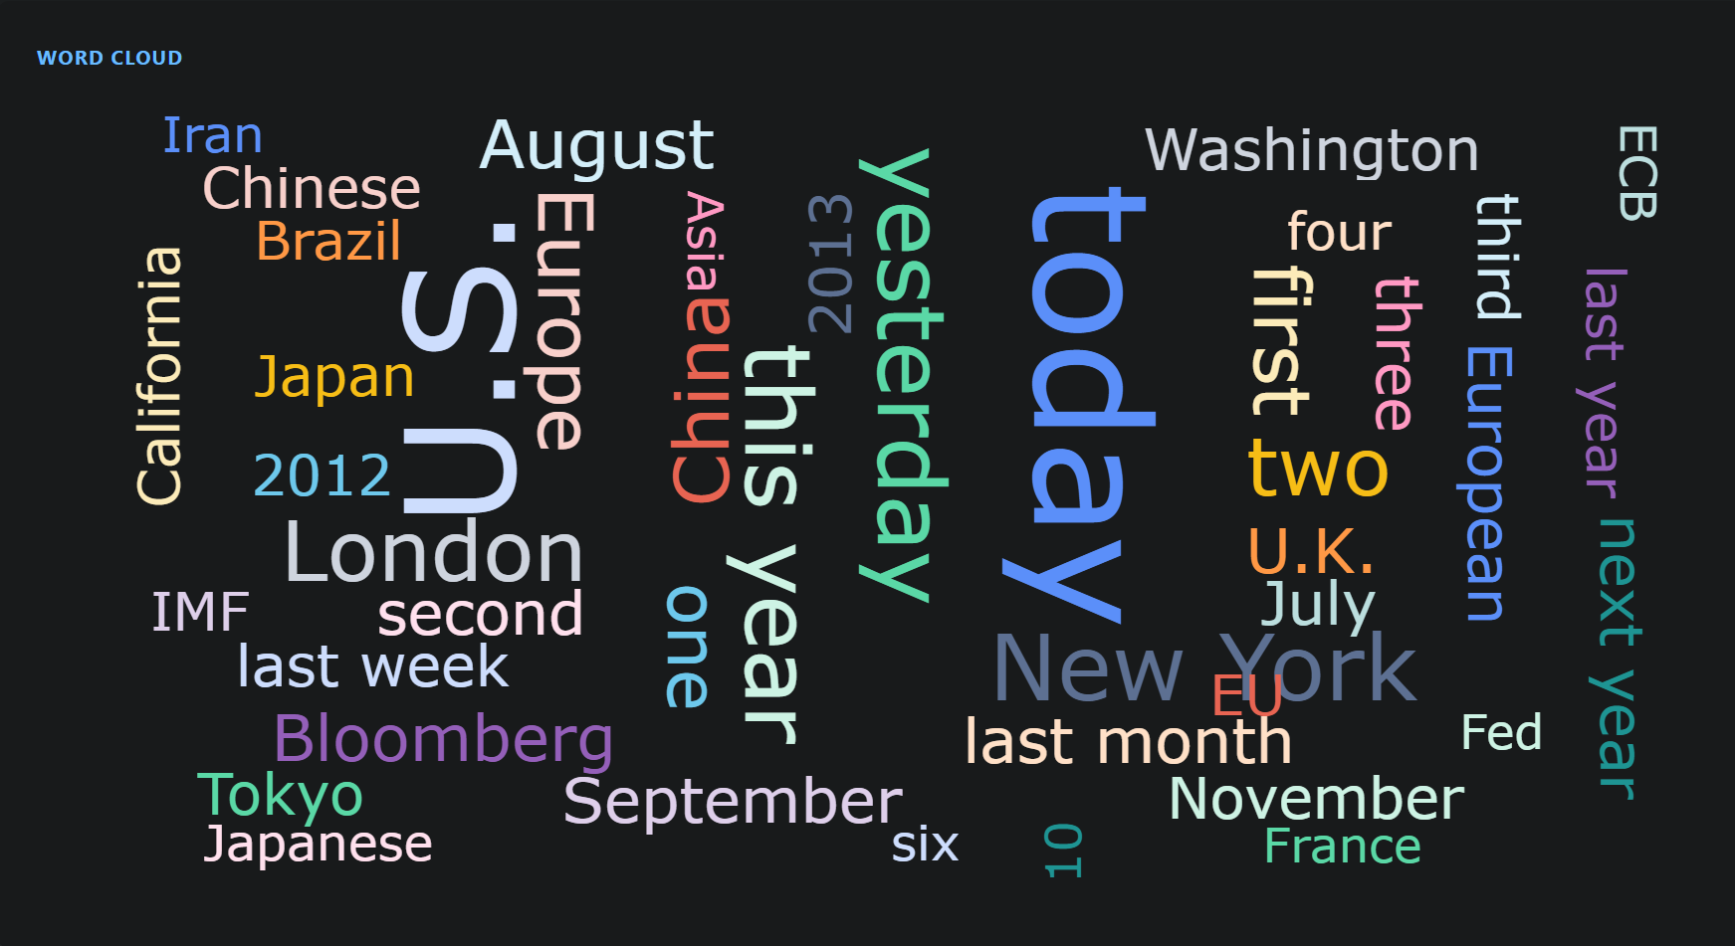
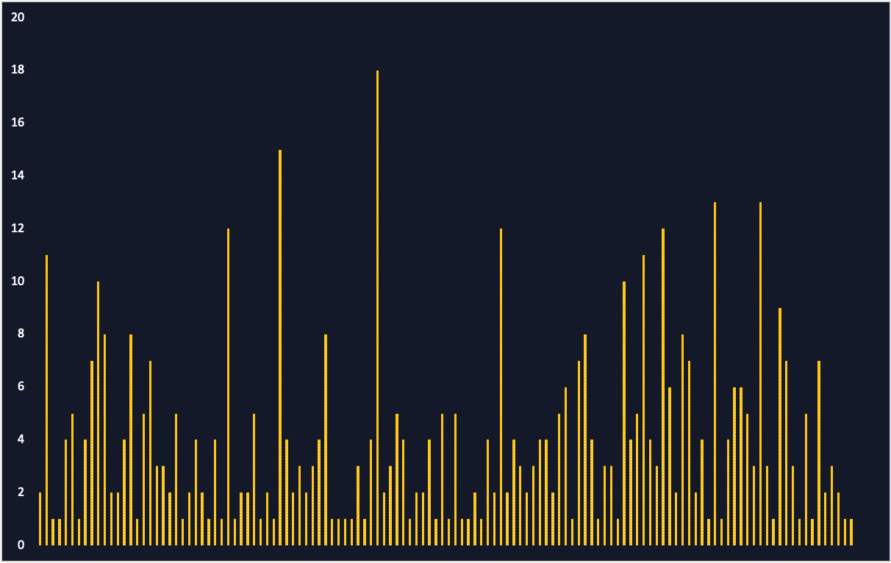
Data Insights
406 Company
>100,000 news report
250 trading days
126 industry
DATA PREVIEW
MODEL
IMPROVEMENT

Slide 7
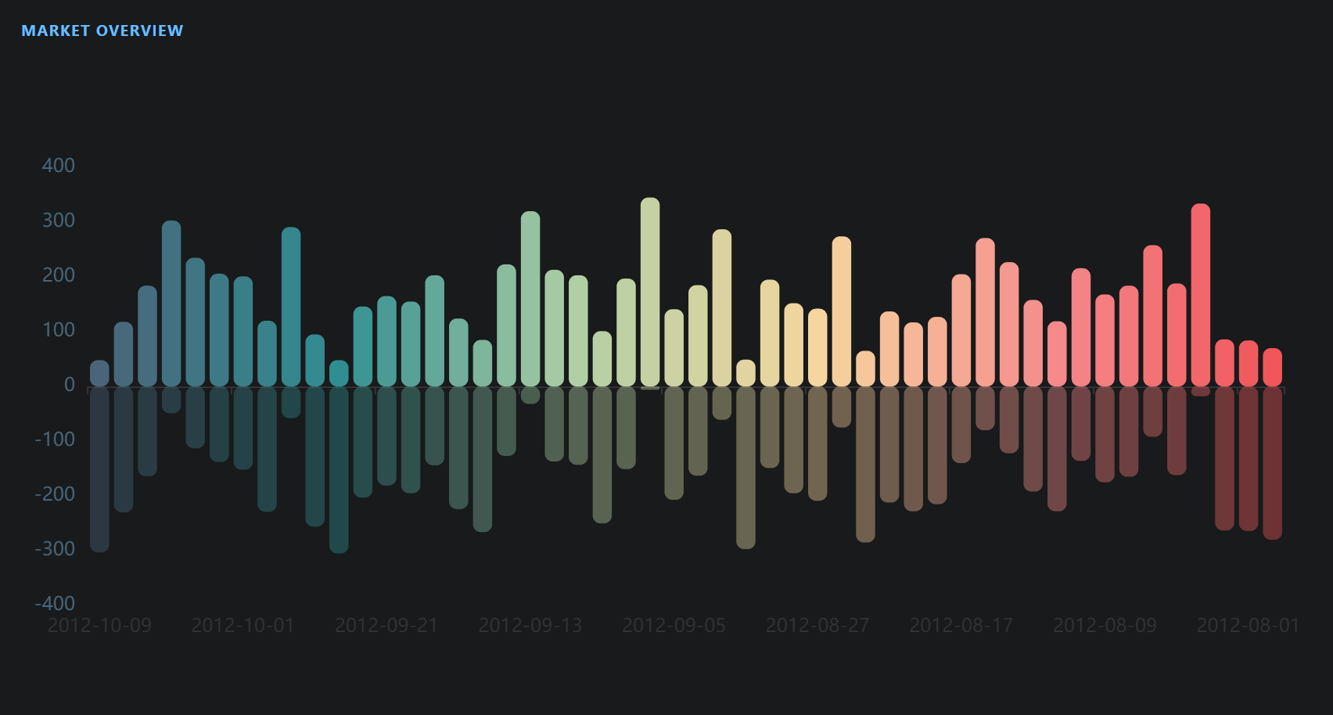
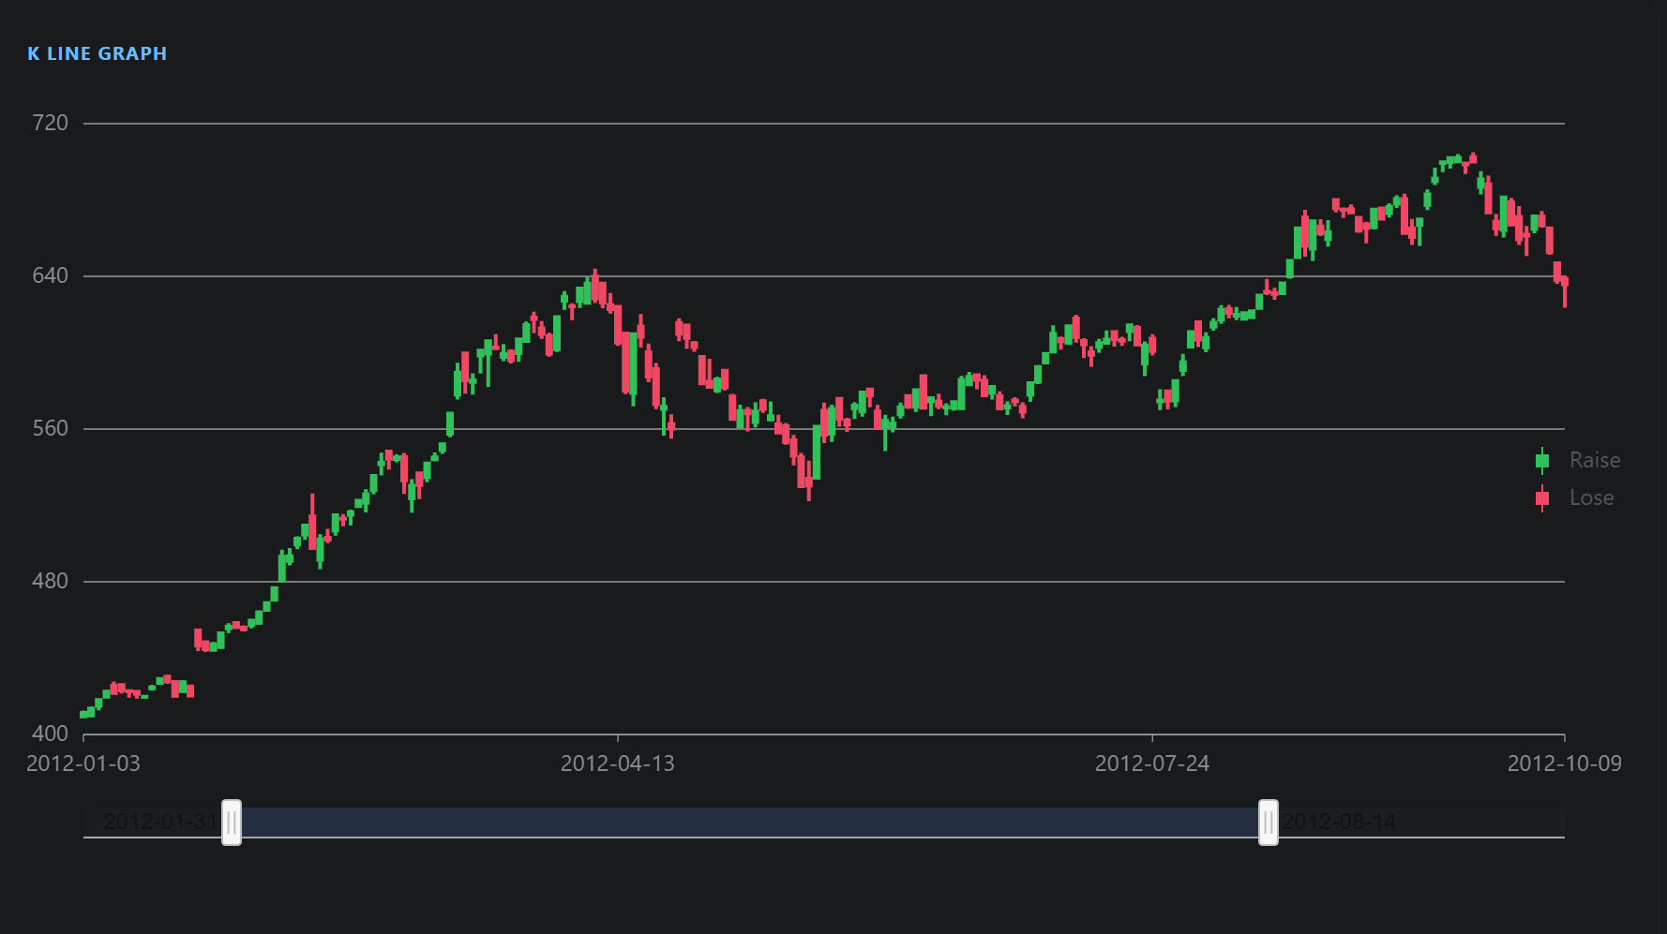
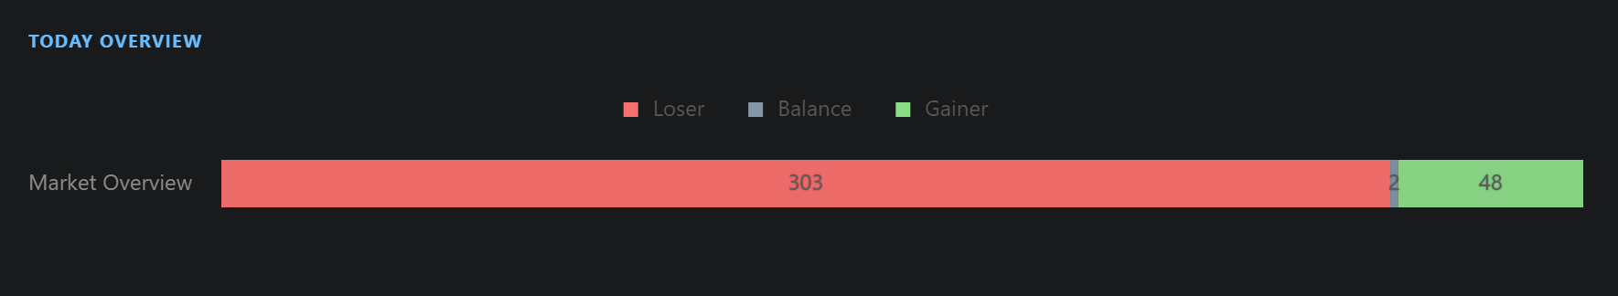
Data Insights
DATA PREVIEW
MODEL
IMPROVEMENT

Slide 8
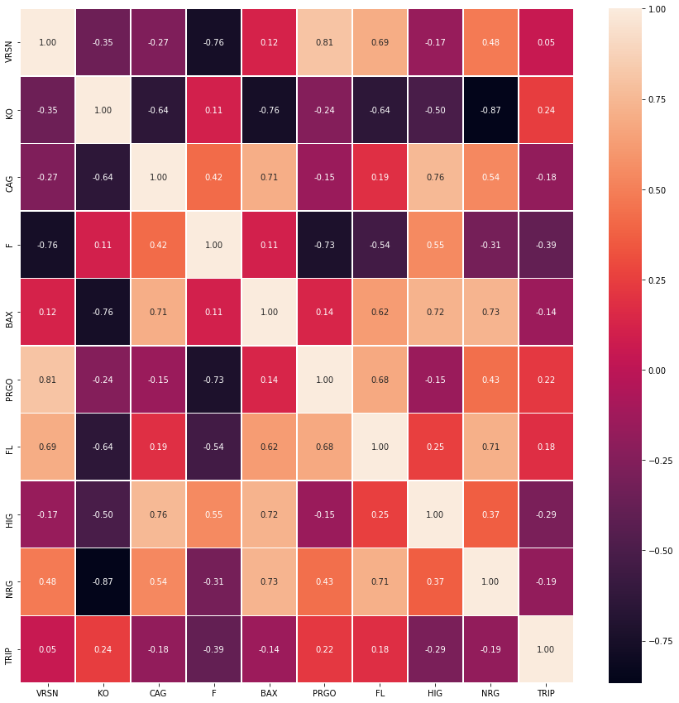

02 Model
1. Correlation Matrix
2. News Relation
Principle：Finding companies that are mentioned in the same News, and we regard those two or more company have a close relationship.
DATA PREVIEW
MODEL
IMPROVEMENT

Slide 9

02 Model
DATA PREVIEW
MODEL
IMPROVEMENT

Slide 10


Main Model
(Model 1) News emotion:
Input
Raw Data
Judge the emotion for every word
Give an emotional grade
Split:
Test Data
Split:
Train Data
Train and Test the model
LightGBM Decision Tree
Link the News to company
Fuzzy semantic alogorithm
Score
DATA PREVIEW
MODEL
IMPROVEMENT

Slide 13
Main Model
(Model 1) News emotion:
Input
Raw Data
Judge the emotion for every word
Give an emotional grade
Split:
Test Data
Split:
Train Data
Train and Test the model
LightGBM Decision Tree
Categorize the company
Fuzzy semantic alogorithm
Score
DATA PREVIEW
MODEL
IMPROVEMENT

Slide 14
(Model 2) Market signal:
Main Model
Input
Raw Data
KDJ
WR
Give grades to stocks
Split:
Test Data
Split:
Train Data
BOLL
RSI
Train and Test the model
Adjusted weights
Linear Regression
Score
DATA PREVIEW
MODEL
IMPROVEMENT

Slide 15
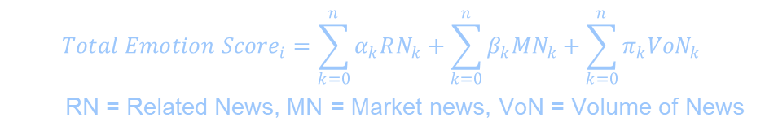
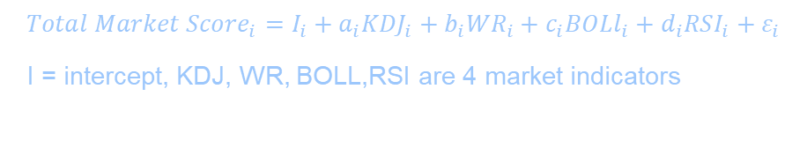
(Model 2) Market signal
Main Model
(Model 1) News emotion
$$Total Emotion {Score}_{i}=\sum_{k=0}^{n}{α_{k}RN_{k}+\sum_{k=0}^{n}{β_{k}{MN}_{k}+\sum_{k=0}^{n}{π_{k}{VoN}_{k}}}}$$
RN = Related News, MN = Market news, VoN = Volume of News
$${Total Market Score}_{i}=I_{i}+a_{i}{KDJ}_{i}+b_{i}{WR}_{i}+c_{i}BOLl_{i}+d_{i}RSI_{i}+ε_{i}$$
I = intercept, KDJ, WR, BOLL,RSI are 4 market indicators
DATA PREVIEW
MODEL
IMPROVEMENT

Slide 16

Mining Relation
1. Correlation Matrix
2. News Relation
Principle：Finding companies that are mentioned in the same News, and we regard those two or more company have a close relationship.
DATA PREVIEW
Model
IMPROVEMENT

Slide 17
Advantage
We have assigned different coefficients to different companies in the Market signal model.
Specification
Interpretability
We have linked each News to the company and can trace the grade of emotion
Traceability
Customized weights
Adjust weights according to the analyst’s preference.
Assist in decision-making
Relation Analysis
Through Mining the relationship of the most related company, we can have a better view.
DATA PREVIEW
MODEL
IMPROVEMENT

Slide 18
Advantage
74%
71%
Accuracy
Model 1: News emotion
Model 2: Market Signal
Add new function is easy as code is clear and organized in logic.
New function
Expansibility
Changing the input data into the database can implement the real-time update function.
Real-time Update
DATA PREVIEW
MODEL
IMPROVEMENT

Slide 19

03 Improvement
FinRocket 2.0
DATA PREVIEW
MODEL
IMPROVEMENT

Slide 20


03 Improvement
FinRocket 2.0
DATA PREVIEW
MODEL
IMPROVEMENT

Slide 21

FinRocket 2.0
Risk Warning
Industry Analysis
Use the signal from market indicators, like KDJ, WR, Boll, RSI, we can detect some risks.
Add a prediction of the whole industry would help the user to grab the trend more easily.
Hedge
It’s also possible to give some hedge suggestions.
DATA PREVIEW
MODEL
IMPROVEMENT

Slide 22
FinRocket 2.0
Risk Warning
Use the signal from market indicators, like KDJ, WR, Boll, RSI, we can detect some risks.
Hedge
It’s also possible to give some hedge suggestions.
DATA PREVIEW
MODEL
IMPROVEMENT

Slide 23






Our Team
Yanpeng
Zhang
Shiyi
Liu
Yuqi
Xiao
Ziqiang
Li
PeilinWu
Ziqin
Wang

Slide 24


Thank You
Chengdu 80 project - SUSTech
Southern University of Science and Technology​
Advisor: Xuning Yang​

Slide 25
Thank You
Chengdu 80 project - SUSTech
Southern University of Science and Technology​
Advisor: Xuning Yang​

